Slide 1
CS 414 - Object-Oriented Design Fall 2020
P3

Slide 2
Meet the Team!
Unspecified Behavior
Adam Anderson
Brent Staab
Keabeth Gonzales
Kai Griem
Maddie Mihevc (Scrum Master)

Slide 3
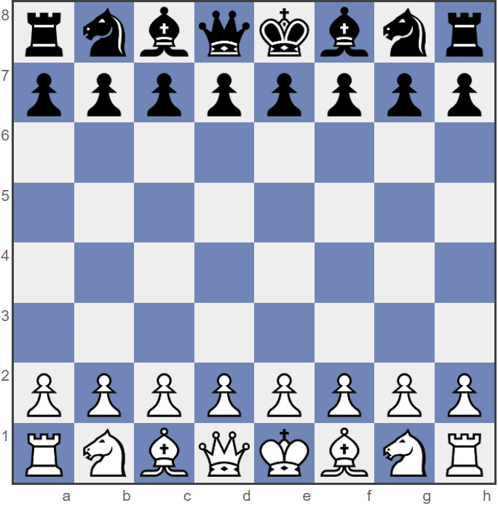
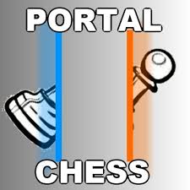
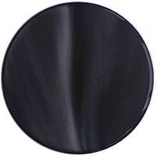
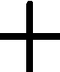


Description of Portal Chess
Portal chess is a derivative of the classical chess game. The main difference is the introduction of two new ‘fairy pieces’ called portals which allow the pieces to move in new and exciting ways.
Image from: https://images.app.goo.gl/dHWwR21iMgRP1wJz5

Slide 4
Development of Project
The Process:
Weekly Scrum meetings at 3 o’clock every Friday
Checked in with each other frequently to learn what each other was working on and struggling with
Tools:
- Github
Microsoft Teams
Google Drawings
Intellij

Slide 5
Completed User Stories
I would like to register with the system to get access
I can log into the system to play a game
I can create a new game
I want to invite other registered users to play games
I can reject or accept an invitation
I want to play multiple games at any given time
I want my game data stored
I want to be able to search other registered users
I want to be able to unregister
I can log out of the system

Slide 6
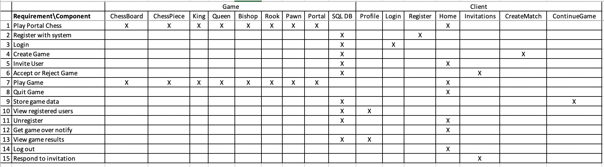
Traceability Link Matrix

Slide 7
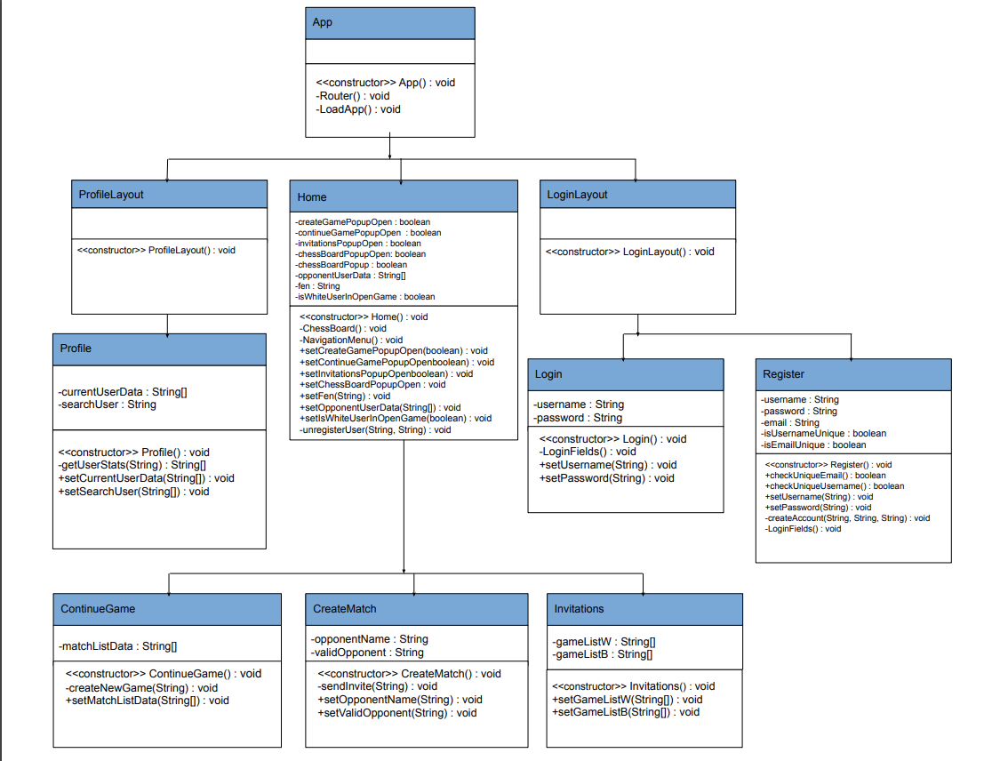
Front-end Class Diagram

Slide 8
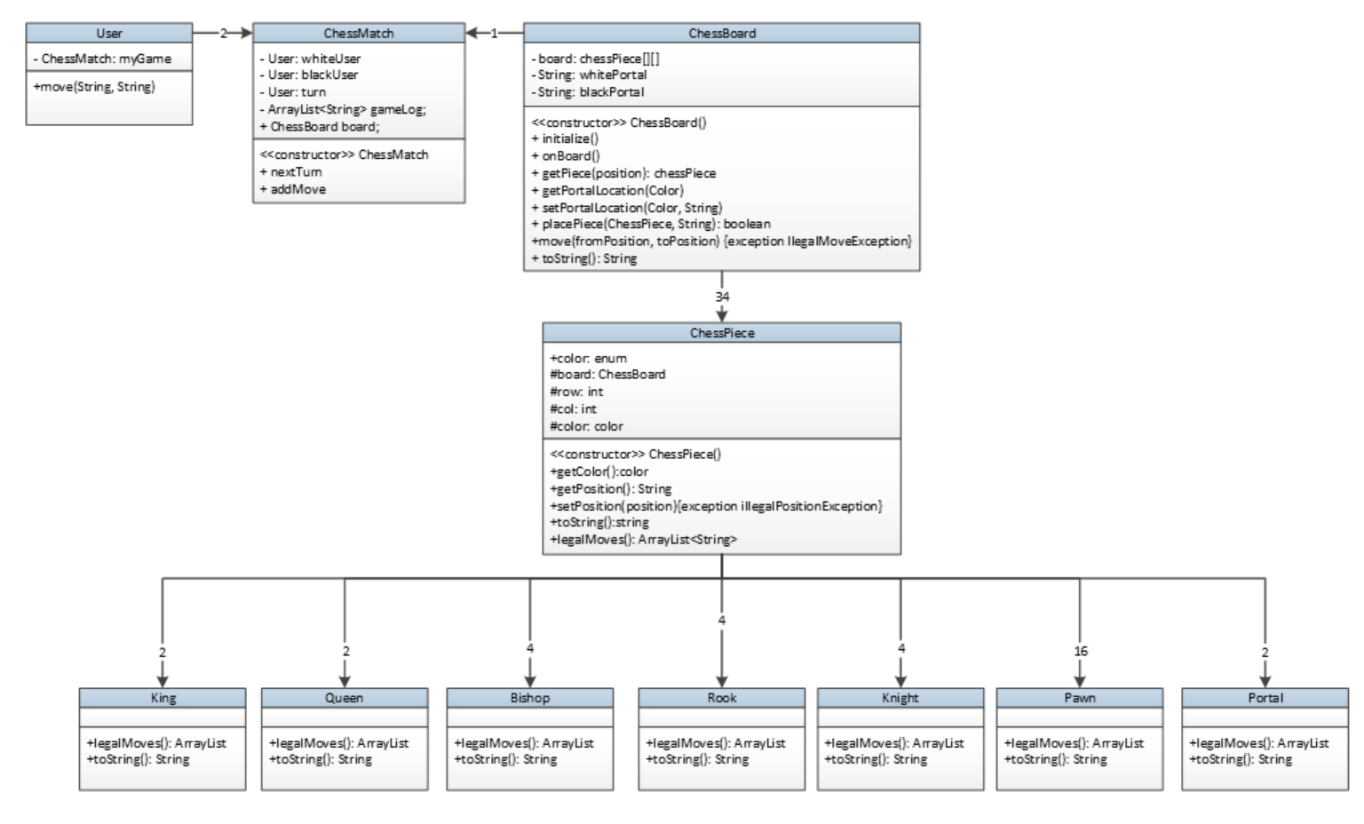
Back-end Class Diagram part 1

Slide 9
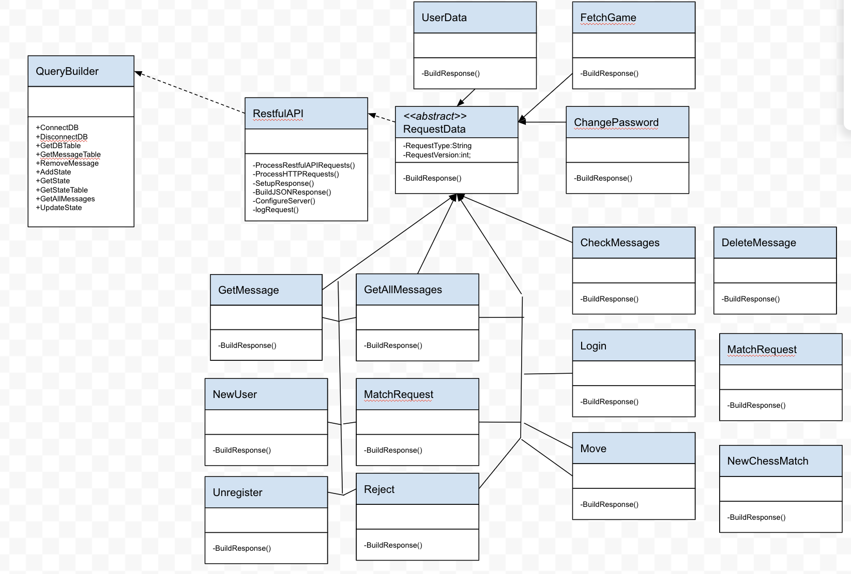
Back-end Class Diagram part 2

Slide 10
Time For Our Demo!

Slide 11
Lessons Learned
While it should have been a lesson we should have learned much earlier on in our degree, we learned that we need to get started working on everything way sooner than we did.
We also learned that working in a virtual team environment is difficult, so we need to maintain communication to know what each other is up to but also offer grace since we are living in unprecedented times.
Overall, we all learned about building an application from scratch that we are looking forward to applying to future careers.

Slide 13
P2 Objectives (for reference only - remove before presenting)
User stories and tasks /1.5
Kanban board /0.5
Design artifacts /2.0
Source code /3.0
Development manual /0.5
Traceability link matrix /1.5
Output of scrum ceremonies /1.0
Presentation /3.0
Peer evaluation /2.0
Total /15.0

Slide 14
Rules
There are several types of Portal chess, but we are planning on implementing the version described by wika57 on his YouTube video. https://www.youtube.com/watch?v=Zq4pJw_nk_0
Setup
The basic rules of classical chess apply
Pieces have the same restrictions, and the overall objective is the same (checkmate the King)
Players place their portals before the game starts
White pieces can only go in row 4
Black pieces can only go in row 5
You can only control your own-colored portal

Slide 15
Rules - continued
Game Play
A piece passes through a portal unless the portal is blocked
A piece can be blocked from entering a portal if a piece of the same color is on the other side.
A piece can take another piece by using the portal
Both portals cannot be occupied at the same time
A piece can check/checkmate people using the portal
A piece must exit the portal in the direction it traveled into the portal
A portal can be moved onto a piece causing it to teleport. *Unless the other portal is occupied*
A player has a choice to move a chess piece or the portal piece in one turn, not both.
If your own chess piece is occupying a portal, you cannot pass another one of your own pieces through the unoccupied portal
A piece can enter either portal regardless of color
Portals can not occupy the same square
A portal can be moved regardless of whether it is occupied or not, the occupying piece does not move with the portal
If a piece occupies one portal and a whole turn phase end without the piece moving from the teleporter it does not teleport.
A Knight can jump over a portal piece
A pawn can become a queen by using a portal

Slide 16
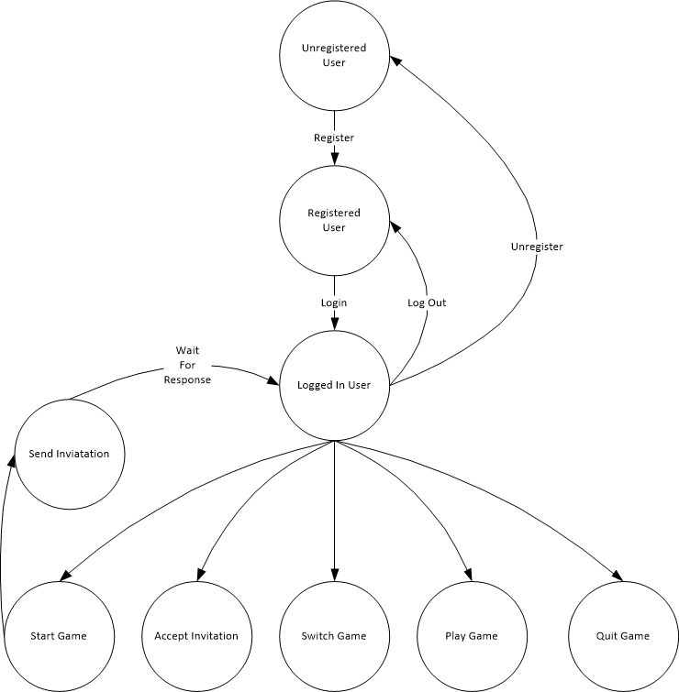
Actors and Stakeholders
Unregistered Users
No user information stored
Not allowed to play a game
Registered Users
Full user profile stored
Includes Name, e-mail, active game(s), game history and results
Logged in user
View profiles
Can play one or more games
Can invite players to a game
Can accept invitations to a game
Play/Quit a game
Unregister

Slide 17
Product Choices - Game
Will not support ‘En passant’ https://en.wikipedia.org/wiki/En_passant
Person who starts the game will make the first move
First person to respond to a game request will be the 2nd player
A game will terminate if a player does not make a move within a given amount of time
Any player who quits will be given a loss and their opponent will will get a win

Slide 18
Retrospective
TODO

Slide 19
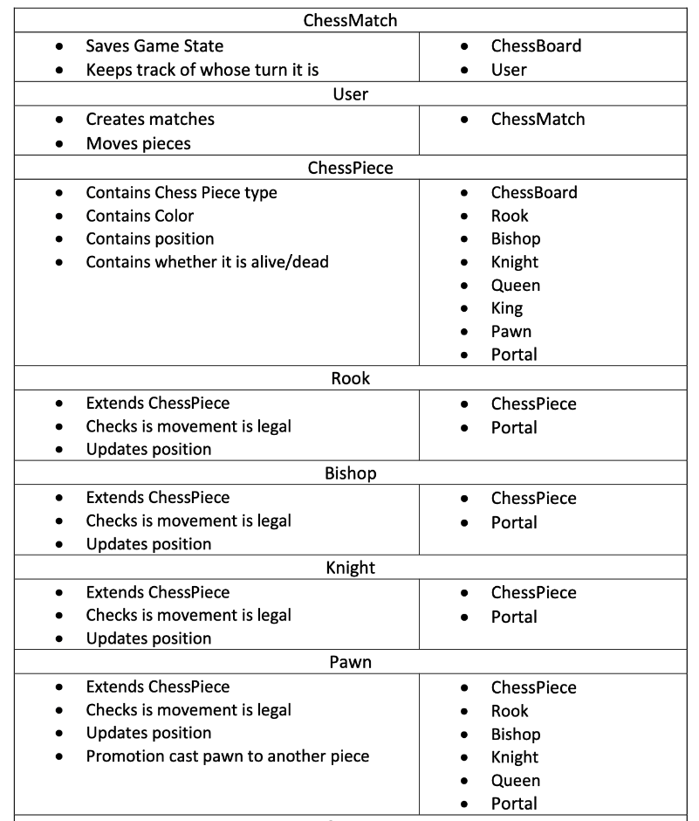
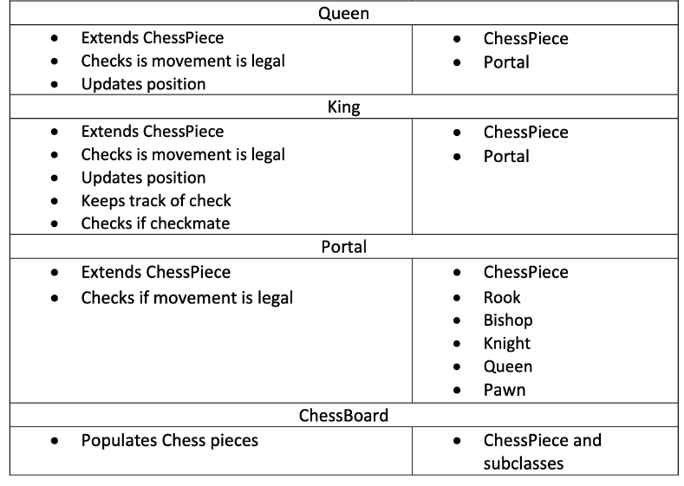
CRC Cards

Slide 20
Acceptance Criteria

Slide 21
Kanban Board
Need a snapshot of our last board with updated tasks

Slide 22
Output of Scrum Ceremonies

Slide 23
Rules
There are several types of Portal chess, but we are planning on implementing the version described by wika57 on his YouTube video. https://www.youtube.com/watch?v=Zq4pJw_nk_0
Setup
The basic rules of classical chess apply
Pieces have the same restrictions, and the overall objective is the same (checkmate the King)
Players place their portals before the game starts
White pieces can only go in row 4
Black pieces can only go in row 5
You can only control your own colored portal

Slide 24
Description of Portal Chess
Portal chess is a derivative of the classical chess game. The main difference is the introduction of two new ‘fairy pieces’ called portals which allow the pieces to move in new and exciting ways.
Image from: https://images.app.goo.gl/dHWwR21iMgRP1wJz5

Slide 25
Rules - continued
Game Play
A piece passes through a portal unless the portal is blocked
A piece can be blocked from entering a portal if a piece of the same color is on the other side.
A piece can take another piece by using the portal
Both portals cannot be occupied at the same time
A piece can check/checkmate people using the portal
A piece must exit the portal in the direction it traveled into the portal
A portal can be moved onto a piece causing it to teleport. *Unless the other portal is occupied*
A player has a choice to move a chess piece or the portal piece in one turn, not both.
If your own chess piece is occupying a portal, you cannot pass another one of your own pieces through the unoccupied portal
A piece can enter either portal regardless of color
Portals can not occupy the same square
A portal can be moved regardless of whether it is occupied or not, the occupying piece does not move with the portal
If a piece occupies one portal and a whole turn phase end without the piece moving from the teleporter it does not teleport.
A Knight can jump over a portal piece
A pawn can become a queen by using a portal

